Slide 1
Wired LANs:
Ethernet

Slide 2
    1 ETHERNET PROTOCOL
In 1985, the Computer Society of the IEEE started a project, called Project 802, to set standards to enable intercommunication among equipment from a variety of manufacturers.
The IEEE has subdivided the data link layer into two subcategories: LLC and MAC.
LLC provides one single data link control protocol for all IEEE LAN while MAC provides different protocols for different LAN.
Notes:
13.#

Slide 3
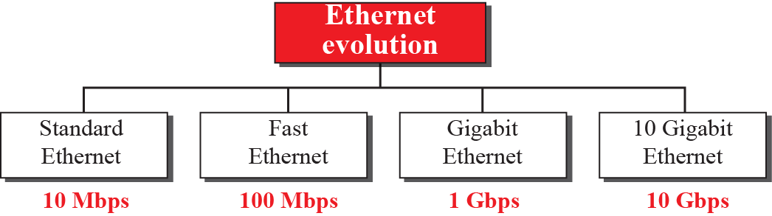
2 Ethernet Evolution
The Ethernet LAN was developed in the 1970s by Robert Metcalfe and David Boggs.
Since then, it has gone through four generations: Standard Ethernet (10 Mbps),
Fast Ethernet (100 Mbps),
Gigabit Ethernet (1 Gbps), and
10 Gigabit Ethernet (10 Gbps)
Figure 2 : Ethernet evolution
Notes:
13.#

Slide 4
    2 STANDARD ETHERNET
We refer to the original Ethernet technology with the data rate of 10 Mbps as the Standard Ethernet.
Although most implementations have moved to other technologies in the Ethernet evolution, there are some features of the Standard Ethernet that have not changed during the evolution.
Notes:
13.#

Slide 5
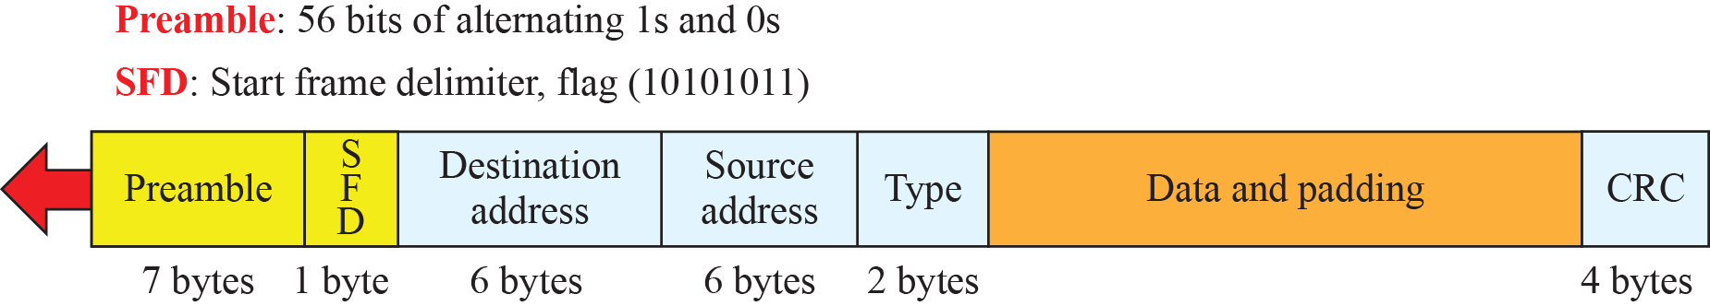
2.1 Characteristics
Standard Ethernet provides the connectionless and unreliable service (no ack).
Figure 3: Ethernet frame
Notes:
13.#

Slide 6
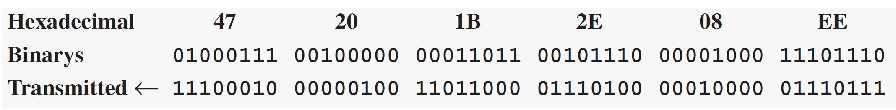
Example 1
Show how the address 47:20:1B:2E:08:EE is sent out online.
Solution
The address is sent left to right, byte by byte; for each byte, it is sent right to left, bit by bit, as shown below:

Slide 7
2.2 Addressing
Each station on an Ethernet network (such as a PC, workstation, or printer) has its own network interface card (NIC). The NIC fits inside the station and provides the station with a link-layer address. The Ethernet address is 6 bytes (48 bits), normally written in hexadecimal notation, with a colon between the bytes. For example, the following shows an Ethernet MAC address:
Notes:
13.#

Slide 8
Unicast, Multicast and Broadcast
A source address is always a unicast address.
The destination address can be unicast, multicast, or broadcast.
If least significant bit of first byte in a destination address is 0 the address is unicast, otherwise it is multicast.
A unicast destination address defines one to one relationship, while multicast is one to many.
A broadcast destination address is forty eight 1s.
13.<number>

Slide 9

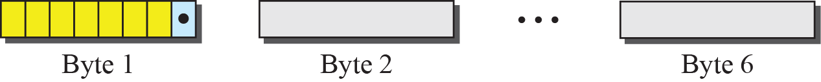
Figure 4: Unicast and multicast addresses
Notes:
13.#

Slide 10
Example 2
Define the type of the following destination addresses:
4A:30:10:21:10:1A
47:20:1B:2E:08:EE
FF:FF:FF:FF:FF:FF
Solution
To find the type of the address, we need to look at the second hexadecimal digit from the left. If it is even, the address is unicast. If it is odd, the address is multicast. If all digits are Fs, the address is broadcast. Therefore, we have the following:

Slide 11
Example 2 (continued)
a. This is a unicast address because A in binary is 1010
(even).
b. This is a multicast address because 7 in binary is 0111
(odd).
c. This is a broadcast address because all digits are Fs in
hexadecimal.

Slide 12
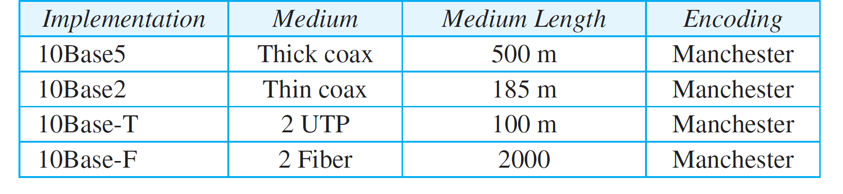
2.3 Implementation
The Standard Ethernet defined several implementations, but only four of them became popular during the 1980s. Table 1 shows a summary of Standard Ethernet implementations.
Table 1: Summary of Standard Ethernet implementations
Notes:
13.#

Slide 13
    3 FAST ETHERNET
In the 1990s, Ethernet made a big jump by increasing the transmission rate to 100 Mbps, and the new generation was called the Fast Ethernet.
The designers of the Fast Ethernet needed to make it compatible with the Standard Ethernet.
The MAC sublayer was left unchanged. But the features of the Standard Ethernet that depend on the transmission rate, had to be changed.
Notes:
13.#

Slide 14
The goals of the Ten-Gigabit Ethernet design can be summarized as follows:
  Upgrade the data rate to 10 Gbps.
  Make it compatible with Standard, Fast, and Gigabit Ethernet.
  Use the same 48-bit address.
  Use the same frame format.
Notes:
13.#

Slide 15

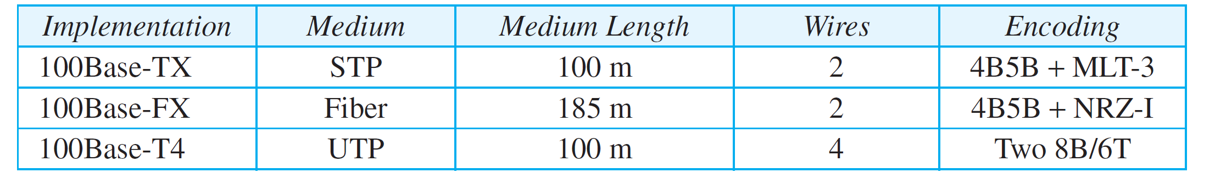
Table 2: Summary of Fast Ethernet implementations

Slide 16
    4 GIGABIT ETHERNET
The need for an even higher data rate resulted in the design of the Gigabit Ethernet Protocol (1000 Mbps).
The IEEE committee calls it the Standard 802.3z.
The goals of the Gigabit Ethernet were to upgrade the data rate to 1 Gbps, but keep the address length, the frame format, and the maximum and minimum frame length the same.
Notes:
13.#

Slide 17
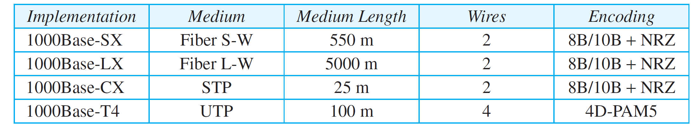
Table 3: Summary of Gigabit Ethernet implementations

Slide 18
    5 10-GIGABIT EHTERNET
In recent years, there has been another look into the Ethernet for use in metropolitan areas.
The idea is to extend the technology, the data rate, and the coverage distance so that the Ethernet can be used as LAN and MAN (metropolitan area network).
The IEEE committee created 10 Gigabit Ethernet and called it Standard 802.3ae.
Notes:
13.#

Slide 19
5.1 Implementation
10 Gigabit Ethernet operates only in full-duplex mode, which means there is no need for contention; CSMA/CD is not used in 10 Gigabit Ethernet.
Four implementations are the most common: 10GBase-SR, 10GBase-LR, 10GBase-EW, and 10GBase-X4. Table 13.4 shows a summary of the 10 Gigabit Ethernet implementations.
Notes:
13.#

Slide 20
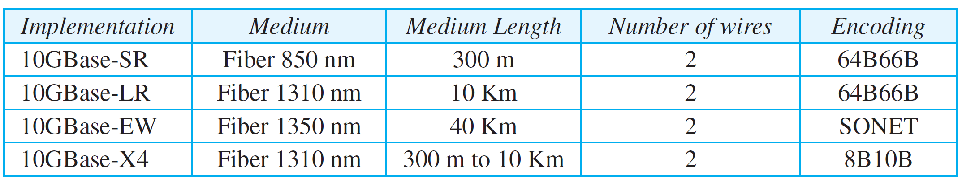
Table 4: Summary of 10-Gigabit Ethernet implementations

Slide 21
Wireless LANs

Slide 22
IEEE 802.11
IEEE has defined the specifications for a wireless LAN, called IEEE 802.11, which covers the physical and data link layers.

Slide 23
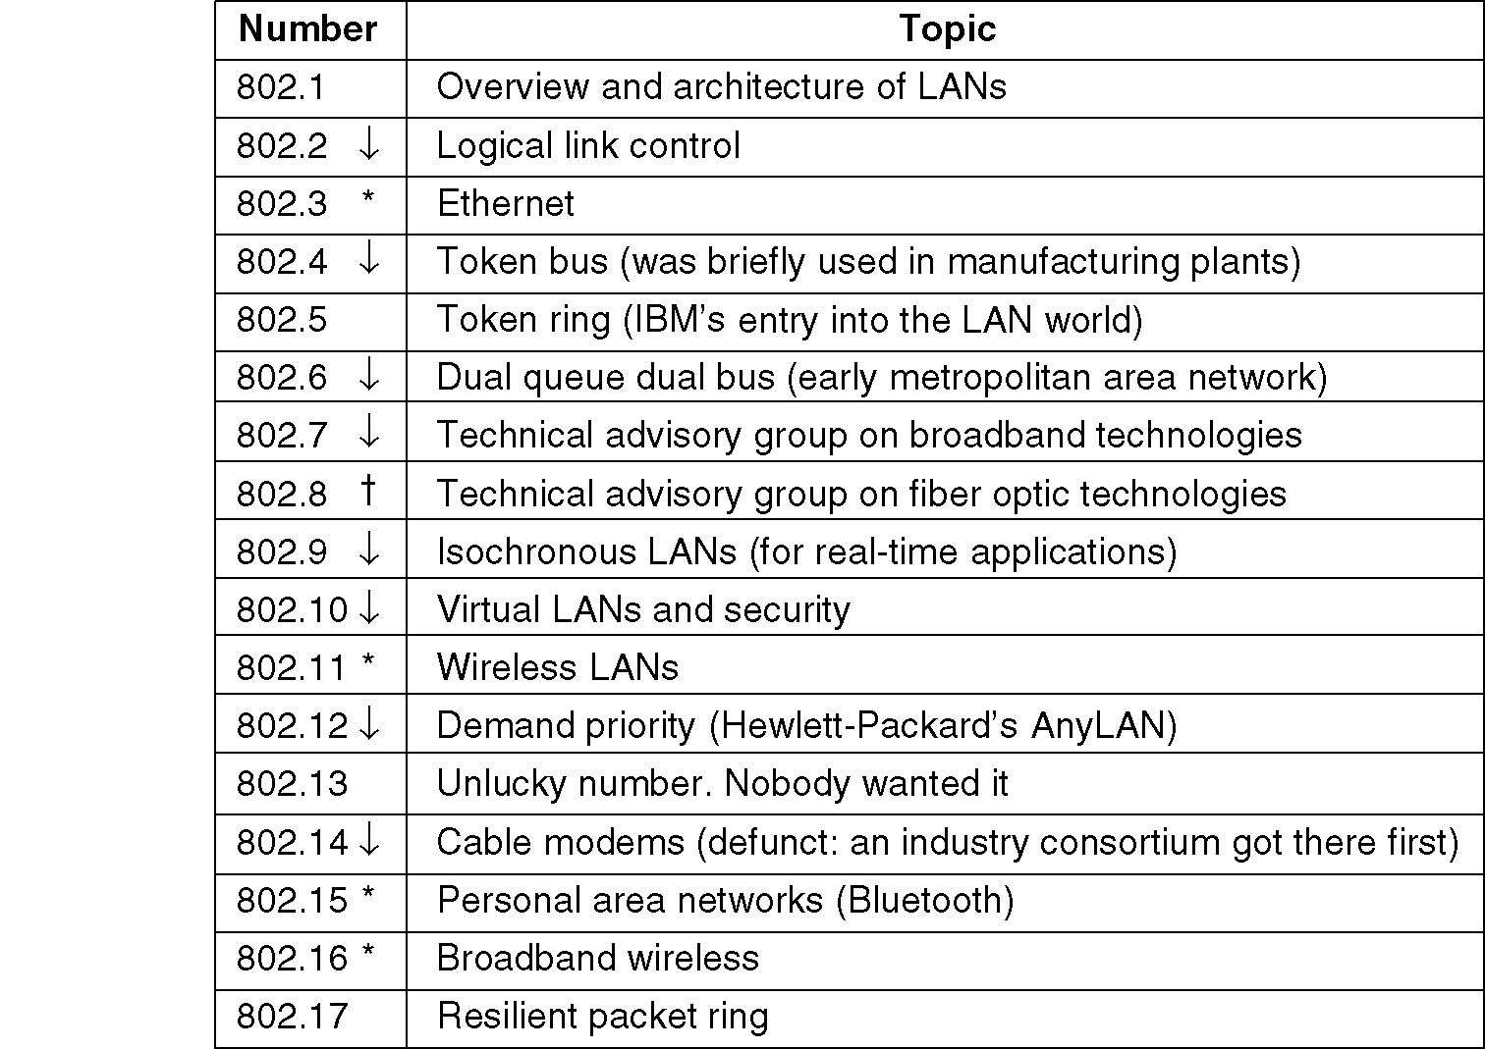
IEEE 802 Standards Working Groups
The important ones are marked with *. The ones marked with ↓ are hibernating/taking over. The one marked with † gave up.

Slide 24
    1 INTRODUCTION
Wireless communication is one of the fastest-growing technologies.
The demand for connecting devices without the use of cables is increasing everywhere.
Wireless LANs can be found on college campuses, in office buildings, and in many public areas.
Before we discuss a specific protocol related to wireless LANs, let us talk about them in general.
Notes:
15.#

Slide 25
Wireless LAN
Operate in a local area
  less than 100 m
Provide access to wired LANs and the Internet
Provide high data rates
  currently, up to 54 Mbps

Slide 26
Major Standards for WLAN
HIPERLAN
  High Performance Radio LAN
  European standard
IEEE 802.11
  US standard
  today, it holds the entire market
  Only this standard will be discussed in our course

Slide 27
1.1 Architectural Comparison
Let us first compare the architecture of wired and wireless LANs to give some idea of what we need to look for when we study wireless LANs.
Notes:
15.#

Slide 28
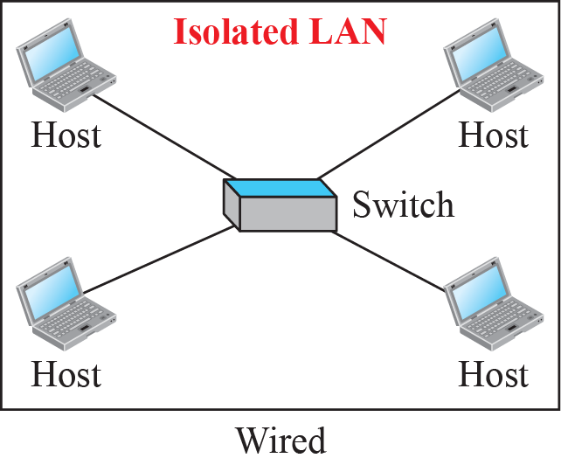
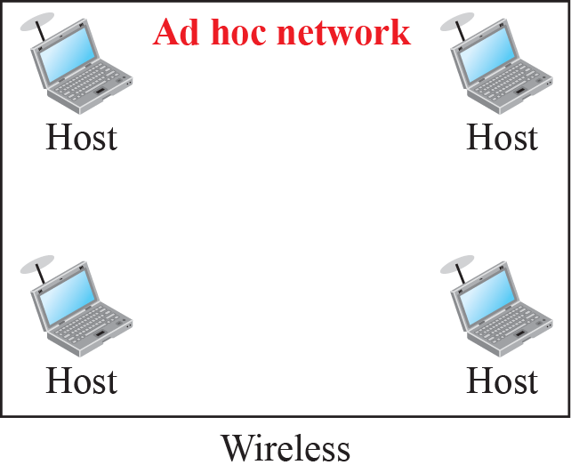
Figure 1: Isolated LANs: wired versus wireless
Notes:
15.#

Slide 29
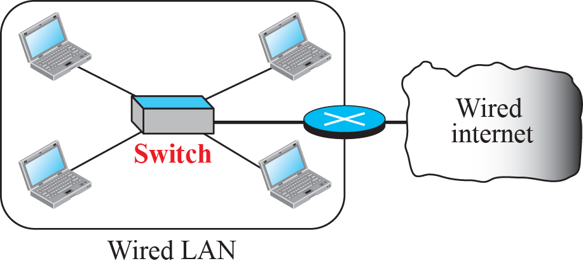
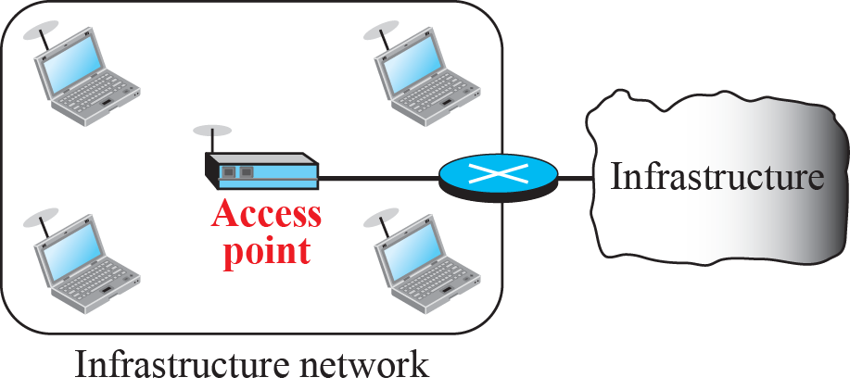
Figure 2: Connection of a wired LAN and a wireless LAN to other
networks
Notes:
15.#

Slide 30
1.2 Characteristics
There are several characteristics of wireless LANs that either do not apply to wired LANs or the existence of which is negligible and can be ignored. Some of the characteristics here to cover the way for discussing wireless LAN protocols.
  Attenuation
  Interference
  Multipath Propagation
  Error
Notes:
15.#

Slide 31
1.3 Access Control
Maybe the most important issue we need to discuss in a wireless LAN is access control—how a wireless host can get access to the shared medium (air). The CSMA/CD algorithm does not work in wireless LANs for three reasons:
Wireless hosts do not have enough power to send and receive at the same time.
The hidden station problem prevents collision detection.
The distance between stations can be great.
Notes:
15.#

Slide 32
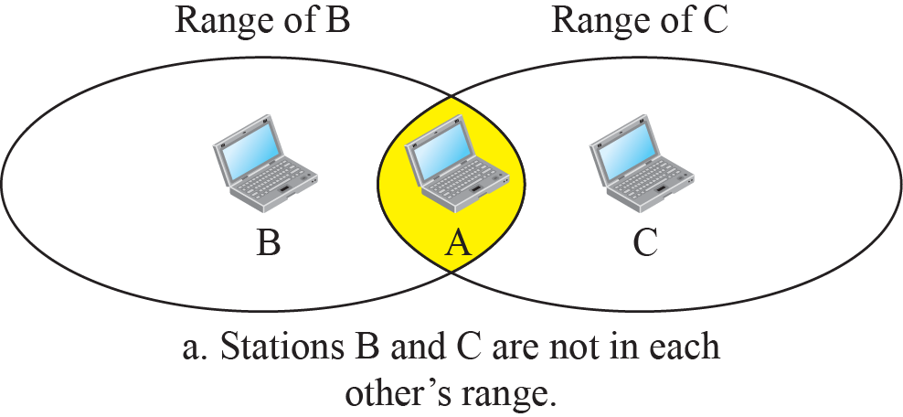
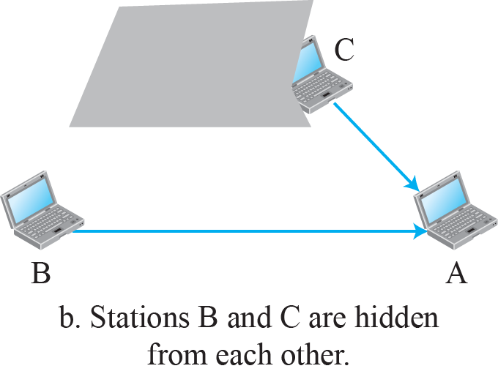
Figure 3: Hidden station problem
Notes:
15.#

Slide 33
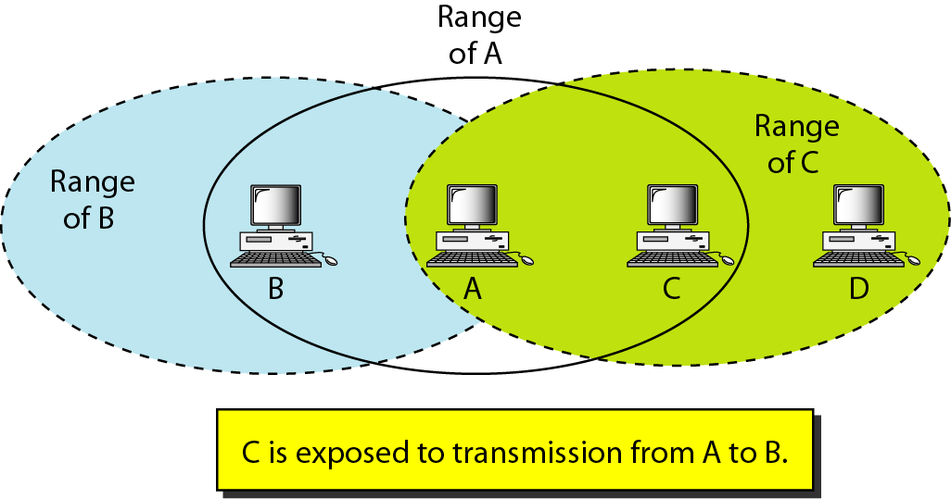
Exposed Terminal Problem

Slide 34
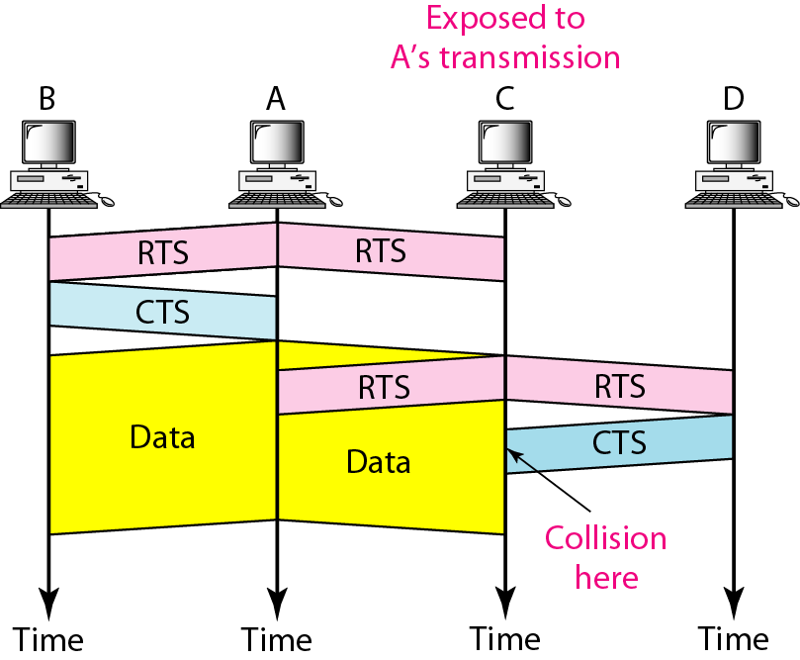
Use of handshaking in exposed station problem

Slide 35
    2 IEEE 802.11 PROJECT
IEEE has defined the specifications for a wireless LAN, called IEEE 802.11, which covers the physical and data-link layers.
It is sometimes called wireless Ethernet.
In some countries, including the United States, the public uses the term WiFi (short for wireless fidelity) as a synonym for wireless LAN. WiFi, however, is a wireless LAN that is certified by the WiFi Alliance.
Notes:
15.#

Slide 36
2.1 Architecture
The standard defines two kinds of services: the basic service set (BSS) and the extended service set (ESS).
Notes:
15.#

Slide 37
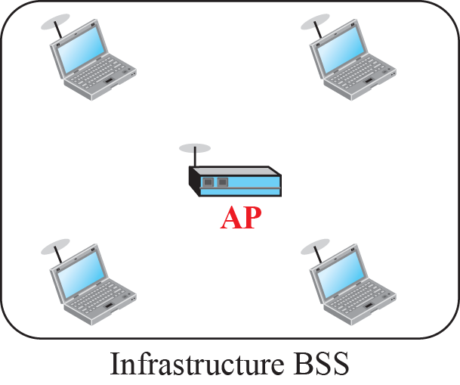
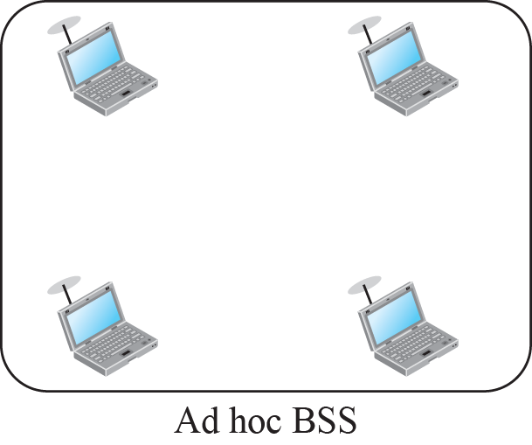
Figure 4: Basic service sets (BSSs)
Notes:
15.#

Slide 38
Two Modes of IEEE 802.11
Infrastructure Mode
  Terminals communicate to an access point.
Ad Hoc Mode
  Terminals communicate in a peer-to-peer basis without any access point.

Slide 39
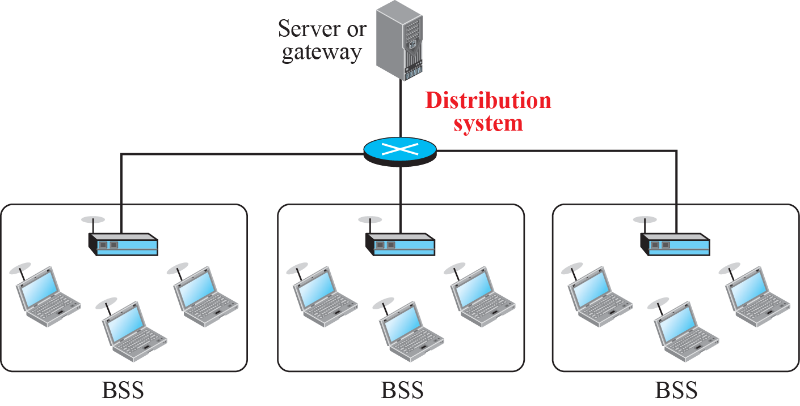
Figure 6: Extended service set (ESS)
Notes:
15.#

Slide 40
    15-3 BLUETOOTH
Bluetooth is a wireless LAN technology designed to connect devices of different functions when they are at a short distance from each other.
A Bluetooth LAN is an ad hoc network. The devices, sometimes called gadgets, find each other and make a network called a piconet.
Notes:
15.#

Slide 41
3.1 Architecture
Bluetooth defines two types of networks: piconet and scatternet.
Piconet: A piconet can have up to eight 8 stations, one of which is called primary, the rest are called secondaries.
All the secondaries stations synchronize their clocks and hopping sequence with the primary.
The communication between primary and secondary can be one to one or one to many.
Scatternet: Piconets can be combined to form what is called scatternet.
A secondary station in one piconet can be the primary in another piconet.
Notes:
15.#

Slide 42
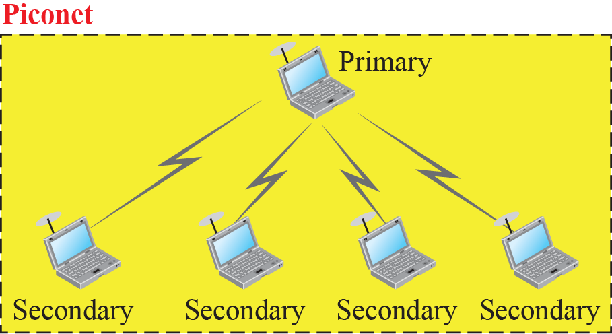
Figure 23: Piconet
Notes:
15.#

Slide 43
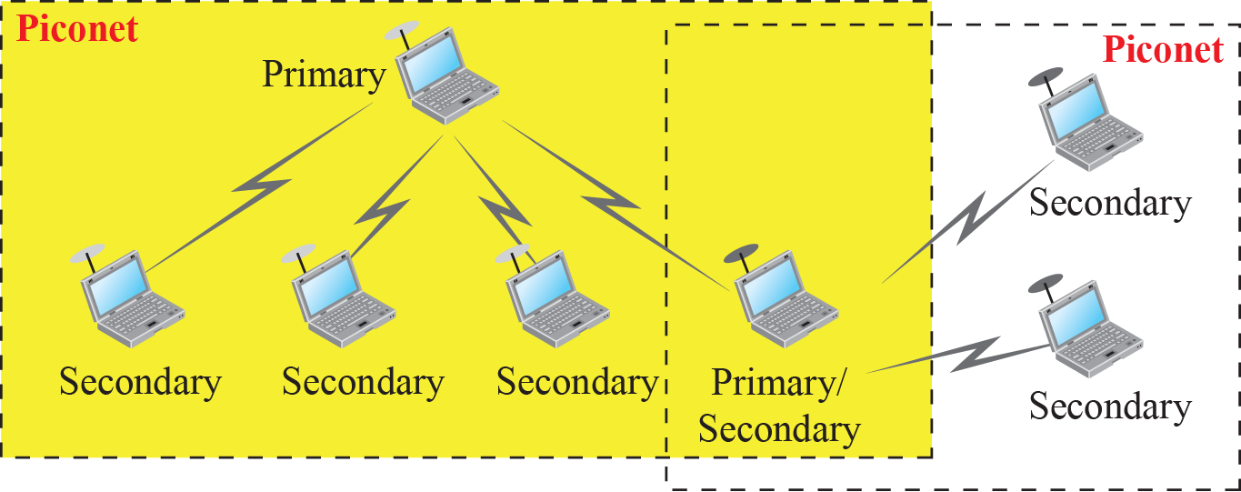
Figure 24: Scatternet
Notes:
15.#

Slide 44
3.2 Bluetooth Layers
Bluetooth uses several layers that do not exactly match those of the Internet model.
Figure 25 shows these layers.
Notes:
15.#

Slide 45
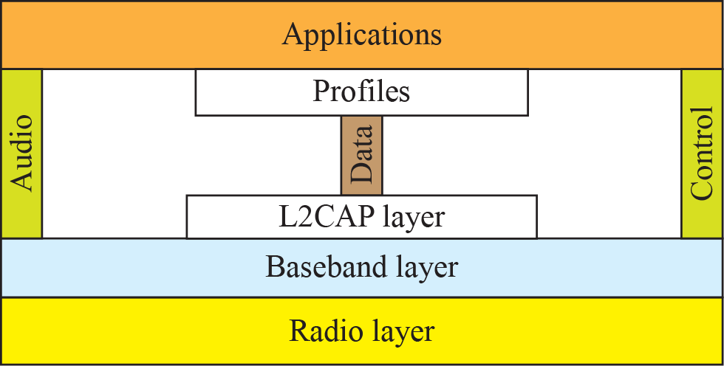
Figure 25: Bluetooth layers
Notes:
15.#

Slide 46
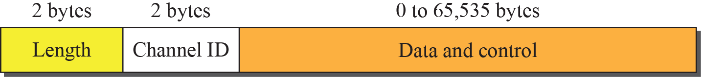
Figure 26: L2CAP data packet format
Notes:
15.#

Slide 47
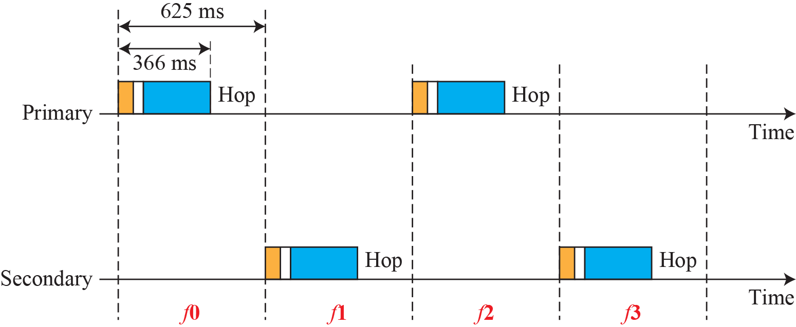
Figure 27: Single-secondary communication
Notes:
15.#

Slide 48
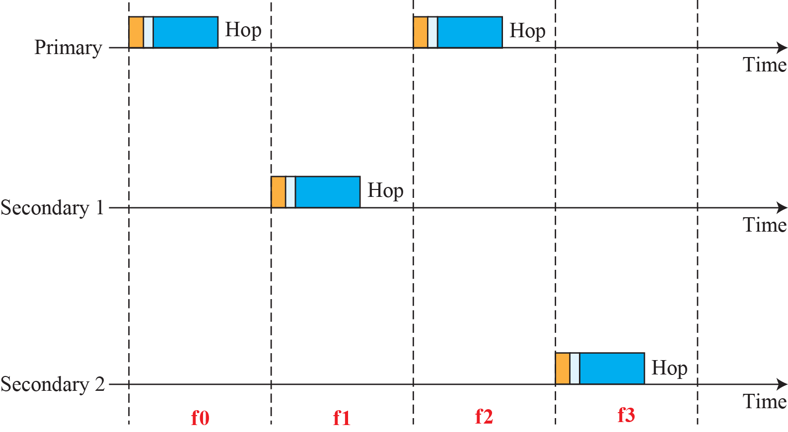
Figure 28: Multiple-secondary communication
Notes:
15.#

Slide 49
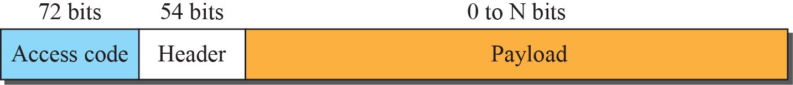

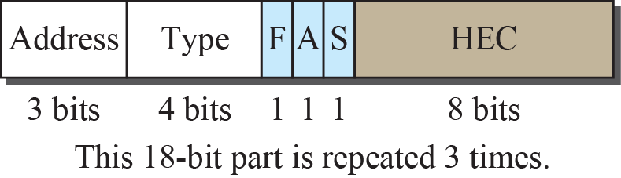
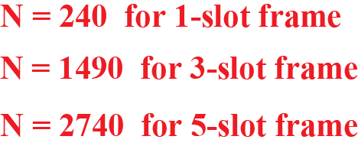
Figure 29: Frame format types
Notes:
15.#

